Slide 1
Signals & Systems
Chapter 0 About This Course
Song Qi
songqi@hust.edu.cn

Slide 2
CONTENTS
5
6
Outline
References
Final Grade
Prerequisites
Course Contents and Objectives
Course Nature

Slide 3
Course Nature
01

Slide 4

Course Nature
Although the study of signal and system problems can be traced back to the Newton era in the 17th century, it has developed into a specialized signal and system discipline, forming a set of theories and methods, in less than half a century.
Signals and Systems is a required professional fundamental course for most undergraduate majors in electronic information in colleges and universities, including Electronics Engineering, Telecommunication Engineering and Electromagnetic & Microwave Engineering.

Slide 5
Course Contents and Objectives
02

Slide 6


Course Contents and Objectives
Contents
Objectives
It mainly introduces basic concepts, theories and analysis methods on determinate signals and linear time-invariant (LTI) systems.
Grasp methods of analyzing characteristics of determinate signals and LTI systems and to determine the responses of LTI systems to input signals.

Slide 7
Prerequisites
03

Slide 8
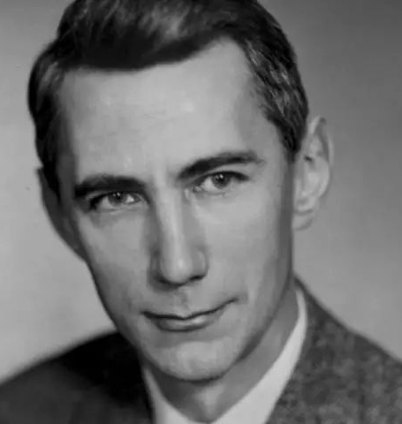
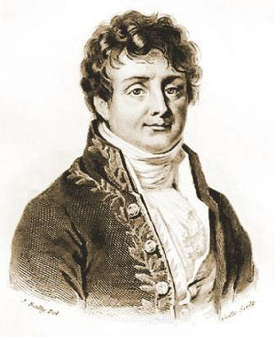
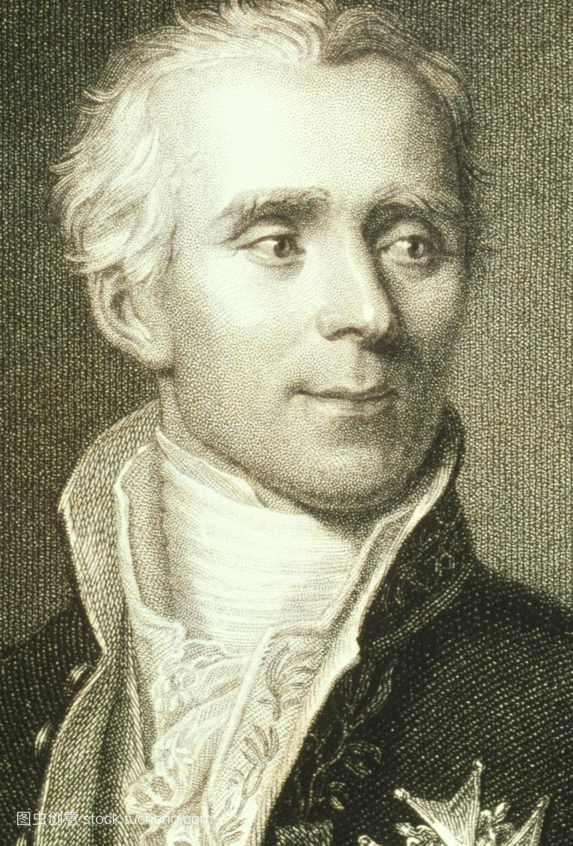
Prerequisites
Calculus
Function of Complex Variable
Linear Algebra
克劳德˙艾尔伍德˙香农
Fundamentals of Electric Circuits
让˙巴普蒂斯˙约瑟夫˙傅里叶
皮埃尔˙西蒙˙拉普拉斯

Slide 9
Final Grade
04

Slide 10
Final Grade
Homework、Experiment、Mooc Study、
Quiz、Attendance、Research Study
30%
70%
Final Exam

Slide 11
References
05

Slide 12
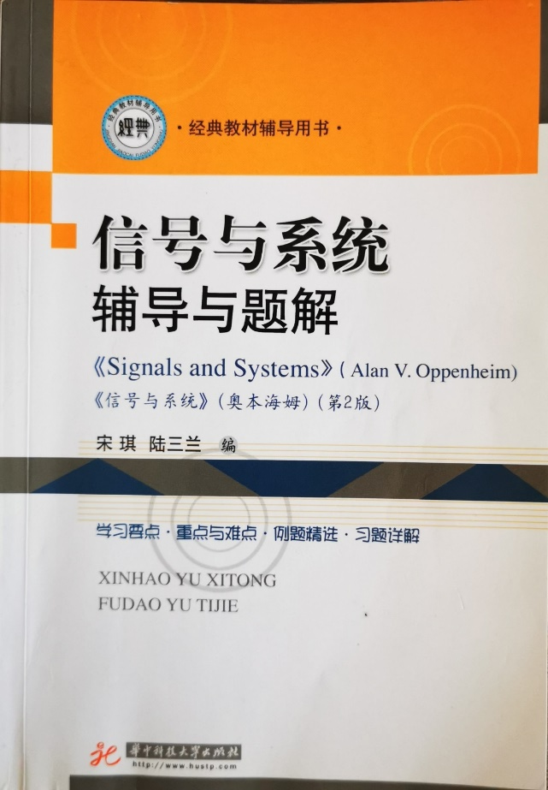
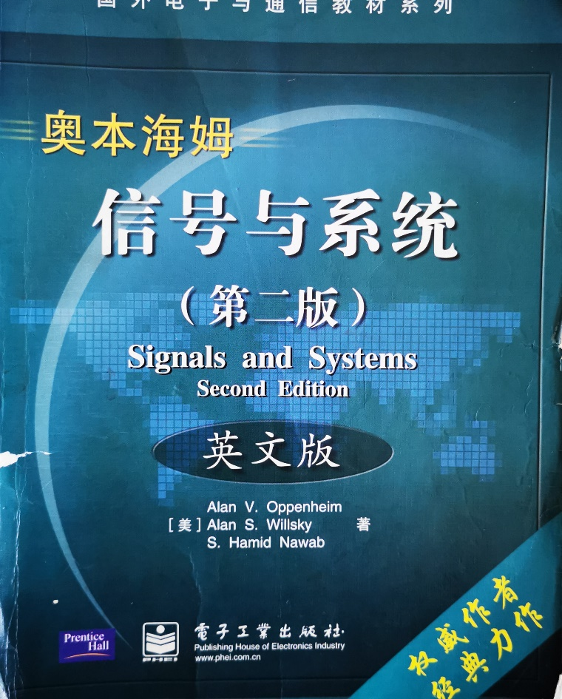
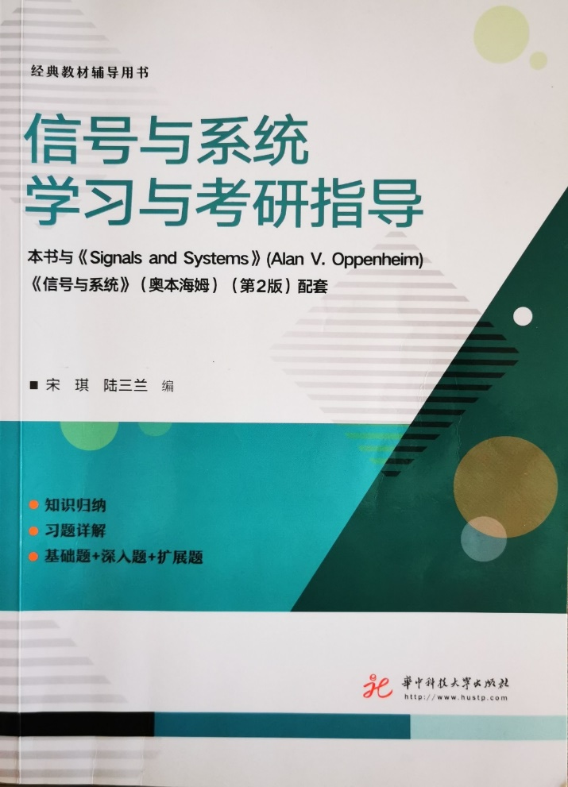
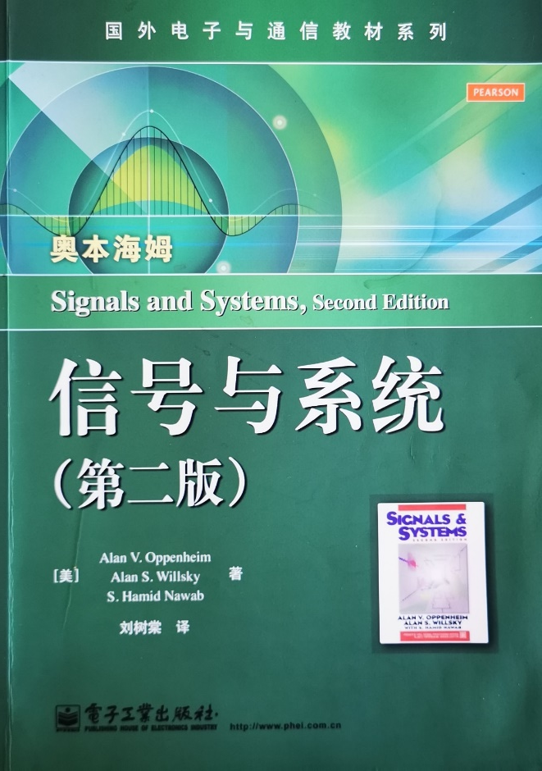
References
信号与系统辅导与题解《Signals and Systems》（Alan V. Oppenheim）, 宋琪，陆三兰 编, 华中科技大学出版社，2012. 06
Signals and Systems (Second Edition), A.V. Oppenheim, A.S. Willssky, S. Hamid Nawab, 电子工业出版社 & Prentice Hall , 2013.01
03
04
01
02
信号与系统学习与考研指导, 宋琪，陆三兰 编, 华中科技大学出版社, 2018. 06
信号与系统(第2版）, 刘树棠 译, 电子工业出版社, 2013.01

Slide 13
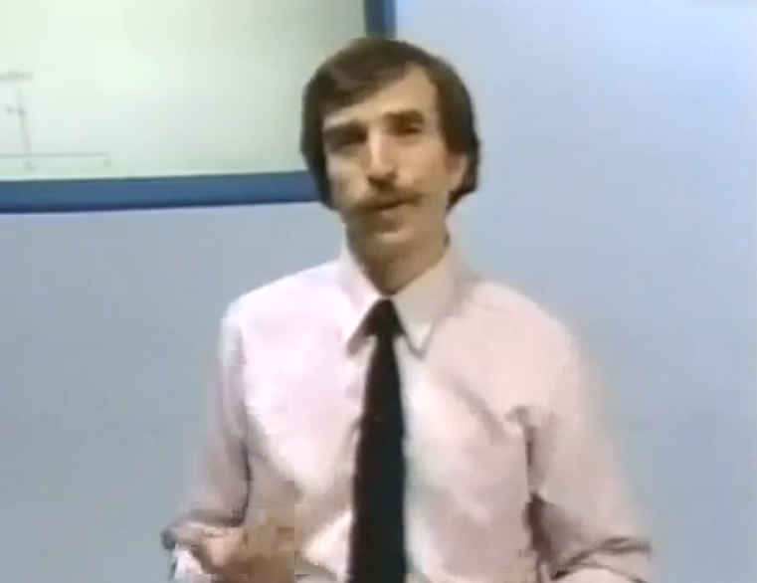
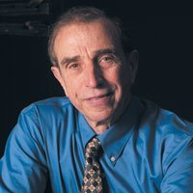
References
奥本海姆(A. V. Oppenheim)教授是美国麻省理工学院电子学研究实验室(ELE)的首席研究员，其研究领域包括在一般领域的信号处理及应用。奥本海默教授是美国国家工程院院士(National Academy of Engineering)和IEEE会士，也是Eta Kappa Nu和Sigma Xi的联谊会会员。同时他还是古根海姆(Guggenheim)学者和以色列特拉维夫大学赛克勒尔(Sackler)学者。奥本海姆教授因其出色的科研和教学工作多次获奖，其中包括IEEE教育勋章、IEEE百年杰出贡献奖、IEEE在声学、语音和信号处理领域的社会与科学成就奖和资深成就奖。2007年他还获得了IEEE Jack S. Kilby信号处理奖章。
著有《信号与系统》和《离散时间信号处理》，《信号与系统》（第一版于1983年出版，第二版于1997年问世）是美国麻省理工学院经典教材之一，《离散时间信号处理》也是离散（数字）信号处理的开山之作，这两本书是电子、通信等学科的权威之作。

Slide 14
Outline
06

Slide 15
Outline
Chapter 1: 6 hrs
Chapter 2: 8 hrs
Part Ⅰ: Time Domain
Part Ⅳ:
State Model
Chapter 3: 4 hrs
Chapter 4 (Including Parts of Chapter 7) : 10 hrs
Part Ⅱ:
Frequency Domain
Chapter 5: 4 hrs
Chapter 9: 10 hrs
Chapter 10: 8 hrs
Part Ⅲ:
Complex Frequency Domain
Chapter 13 : 5 hrs

Slide 16
Don‘t aim for success if you want it; just do what you love and believe in, and it will come naturally. 如果你想要成功，不要去追求成功；尽管做你自己热爱的事情并且相信它，成功自然到来。
Life is not all roses. 人生并不是康庄大道。

